Slide 1
Mrs. Thompson’s First Grade Class
Notes:
http://www.teacherspayteachers.com/Store/Young-And-Lively-Kindergarten

Slide 2
ttendance is very important! Students should be in the classroom by 8:20 each morning. Most of our First Grade experiences are group oriented and involve interaction with classmates and hands-on materials. It will be difficult to reinvent some of the activities into take-home work. If your child is absent, please call the office by 8:20 to let us know.
is for birthday treats & book orders. Birthday treats are welcomed in Room 14! Please let me know which day you plan in sending them. We will celebrate when we have flexible time.
Scholastic Book Club orders will be coming home throughout the school year. I encourage you to place your order online – we will receive $3 for books for each of your first orders as well as bonus points to help our classroom library!

Slide 3
is for communication. Our main line of daily communication will be through your child’s Daily Folder. Please check this folder every night. I will also communicate through our classroom website, e-mails, telephone calls, progress reports, and parent teacher conferences. I encourage you to contact me if you have any questions or concerns at any time. There is no need to wait until parent conferences if you have a concern about your child's progress. Feel free to send me an email, call me at school, or send a note to school in your child’s folder.
is for our discipline procedures. We will use collaborative problem solving to solve problems as they arise. I will keep in contact with you about you child’s behavior.

Slide 4
is a reminder that in an emergency, it is important that we have current contact telephone numbers. Please inform us if address, home, work, or cell phone numbers change throughout the school year.
is for field trip! We will take one field trip this year. Information for the trip will be sent home closer to time for the trip!
is for gym class! We will have gym class on C and E days. I will let you know our weekly schedule on our website updates. Please make sure your child wears tennis shoes on these days.

Slide 5
is for homework. Starting in next week, I will send home homework each week for your first grader. Homework is intended to practice skills already learned in the classroom. If homework ever causes frustration, please write a note on it and send it back to me.
Be NVOLVED in your child's learning!
is for joining our PTO! Throughout the school year there will be a variety of special classroom activities, celebrations, and PTO meetings. We will have several fundraisers to help support our school. I encourage you to attend all functions and become involved!

Slide 6
is for keeping up with the classroom website! I will update the site and email you weekly. Check it out to see what your first grader has been learning for that week as well as upcoming events!
is for library books! We will be visiting our library each week on B days. Students will start bringing home a library book in September. I recommend keeping these books in your child’s backpack so they don’t get lost.

Slide 7
is for our new Math series! Fort Zumwalt has adopted new math materials that coincide with the Common Core standards. This will be a very exciting change! Please let me know if you ever have any questions about work your child brings home.
is for Nurse! We have a full time nurse at our school! If your student requires medication to be taken at school please make sure that you fill out the necessary forms in the office. Our nurse handles all medication. Also, if there are any allergies that we need to be aware of please let us know.
is for office check-ins and check-outs! Please make sure to go to our office when you need to check-in or check-out your student.

Slide 8
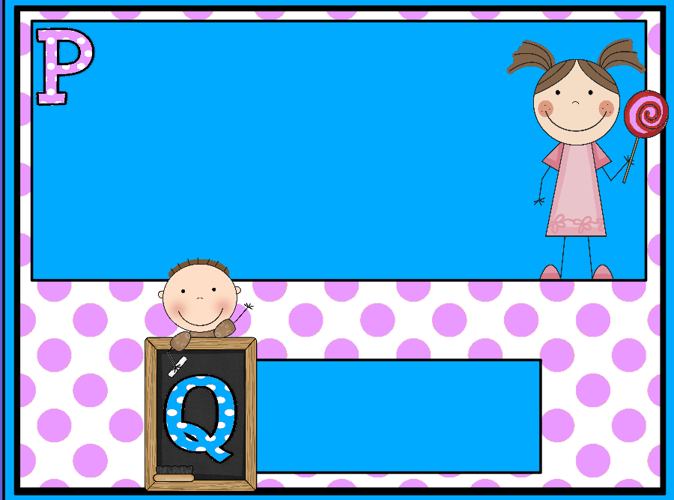
is for parties! I will need someone to be in charge of the fall and winter parties. I have sign-up sheets for you to sign if you’re interested. If you aren’t able to attend, it would be appreciated if you donated items! Thank you in advance for all of your help!
is for questions! Please call, email, or send a note if you have any questions. I am here to help!

Slide 9
is for recess. We will have 2 recesses each day. When we are able, we will be outside. Please send your first grader in weather-appropriate clothing!
is for Sight Word Challenge. Sight Word Challenge is a booklet with lists of sight words your first grader will be learning. I will assess your first graders weekly and give them new lists as they pass their previous lists. Since each child moves at a different pace, not everyone will be on the same list. I will post the list they should pass that week on the class website to practice at home. The Sight Word Challenge booklet will stay at school.
is for tying shoes! Please work on this with your child at home. Once they become proficient at tying shoes, they will become one of my "Tying Teachers" and assist in teaching other students with learning to tie shoes.

Slide 10
Each child is UNIQUE and special. They enter my classroom with different skills, personalities, experiences, backgrounds and learning styles. It is my aspiration to foster their individual strengths and help each child develop to his/her fullest potential; academically and socially. My goal is to teach them to fall in love with learning!
is for volunteers and visitors! We love having volunteers in our school! Please fill out the volunteer form in this packet and let me know if you are able to come help us! All volunteers and visitors must check in at the office to receive a visitor’s pass.
is for Word Study. Instead of a weekly spelling list, your child will study a spelling pattern and complete many activities throughout the week to apply spelling strategies. The list will not be sent home to drill and practice. However, a pattern may come home to brainstorm different words with your first grader.

Slide 11
is for eXtra supplies! Since most of our supplies are consumables, I may request refills during the year. Thank you in advance!
is for YOU! Always remember you are a teacher too! There is no one who is more influential in your child’s life than you!
is for ZzZzZz...please make sure that your child gets plenty of rest each night. Setting and keeping a bedtime helps children to be alert and ready to learn each day!

